Slide 1
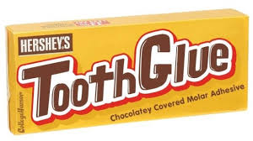
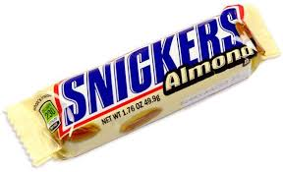
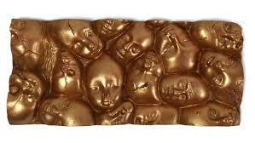
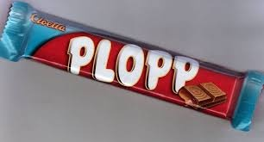
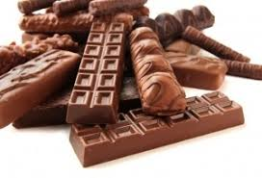
Charlie and the Chocolate Factory
L.O.
To use vocabulary in a creative way to construct a poem
Creative Poem

Slide 2
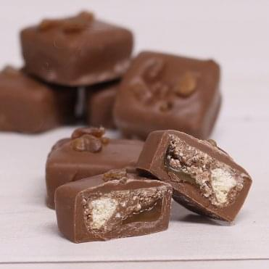
My Chocolate Poem (inspired by Roald Dahl)
L.O.
To use vocabulary in a creative way to construct a poem
(12) Afterthoughts
(0) Where are you?
(1) Metaphor for what it looks like
(11) Then bite into it and describe it
(2) Detail for visual impact
(10) Describe the sensation in your mouth when you 1st put it in
(3) Describe its size and shape
(9) What is the result of touching it?
(4) What might you say to it?
(8) Describe its texture to the touch
(6) What sounds do you hear around you whilst focusing on the chocolate?
(7) Imagine its aroma and describe it
(5) If it had a voice what would it say to you?

Slide 3
Tantalising Temptation (Example, following the model)
The plate in the café smouldered with something heavenly.
This was the food of the gods.
The little parcels stacked on a plate
Oozing umber opulence.
I want to devour you, I say in my head.
If you do, you’ll die of over-indulgence, it replies.
Meanwhile, I hear the lips of other customers smacking.
Aromas of peppery almond waft in my direction.
I surreptitiously grab one when no-one is looking,
But regret its sugary wetness on my sweaty palm.
I have no option but to suck it.
Before I can bite into it, my teeth are glued tight.
The chocolate demon has trapped me.

